Slide 1


Project Based Seminar Presentation On “ HYPERLEDGER FABRIC : A BLOCKCHAIN TECHNOLOGY ” By
Pune Institute Of Computer Technology Department of Information Technology
Guide :
Prof. T. A. RANE
3946 - SACHIN KUNTE
3961 - SHARAN RAJANI
3977 - SHREYAS WAGHMARE
3002 - ADARSH NAIR
Day and Date of Exam : Saturday, 21 April 2018

Slide 2
Objective
To provide in-depth explanation of the architecture and working of Hyperledger Fabric and how it can be used for rapid and easy development of a Distributed Blockchain Application for Supply Chain and Logistics Management.

Slide 3
Abstract
Blockchain Technology has attracted attention as the basis of crypto currencies such as Bitcoin, but its capabilities extend far beyond that, enabling existing technology applications to be vastly improved and new applications never previously practical to be deployed. Hyperledger Fabric is a flexible permissioned blockchain platform designed for business applications beyond the basic digital coin addressed by Bitcoin and other existing networks. A key property of HLF is its extensibility, and in particular the support for multiple ordering services for building the Blockchain. Our presentation explains a Perishable Goods Supply Chain Network using Hyperledger Composer.

Slide 4
Literature Survey
Attempts for Digitisation
Digital Cash
Second Wave – Web Based Money
The Regulatory Bust
E-Gold Failed
US Government Act

Slide 5
Problems before Blockchain
Guarantee authenticity of items/transactions.
How to avoid intermediary in transactions.
How to ensure the transaction information is tamper proof.
How to value something online - Double spending problem.
Notes:
20-Apr-18
5
5
5

Slide 6
What is Blockchain ?
Immutable Ledger – Append Only
Distributed
Blocks are chained together
Solves double spending problem
Notes:
20-Apr-18
6
6
6

Slide 7
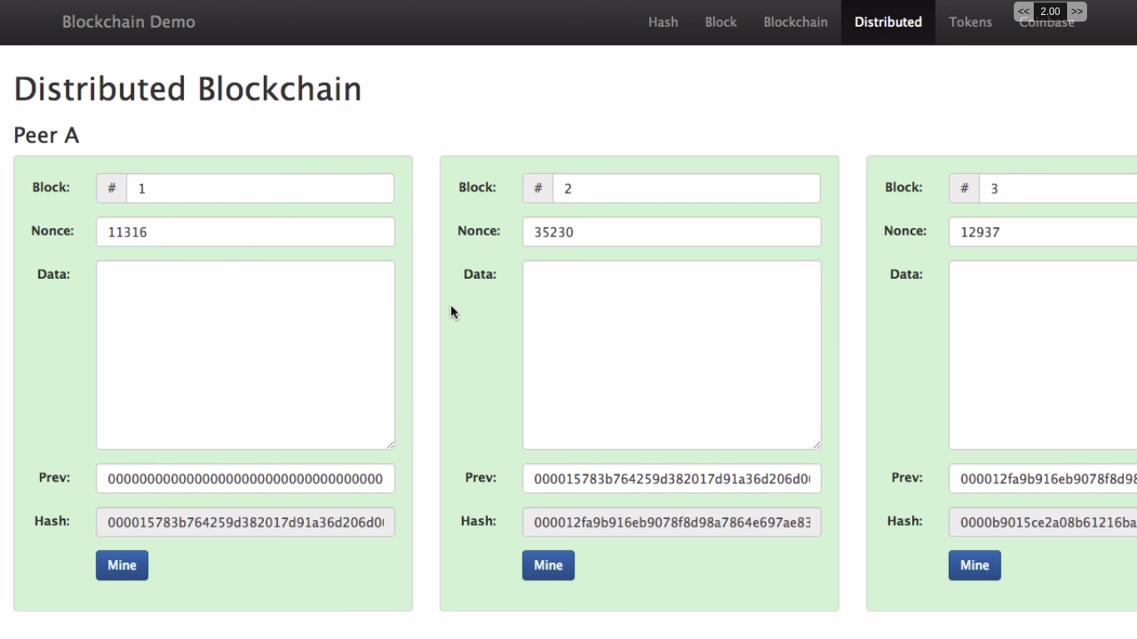
Notes:
20-Apr-18
7
7

Slide 8
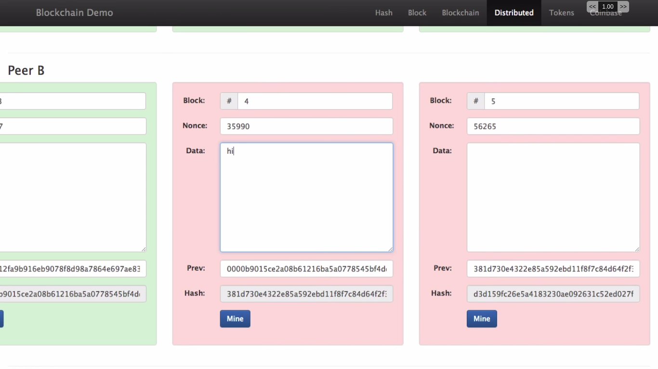
Notes:
20-Apr-18
8
8

Slide 9
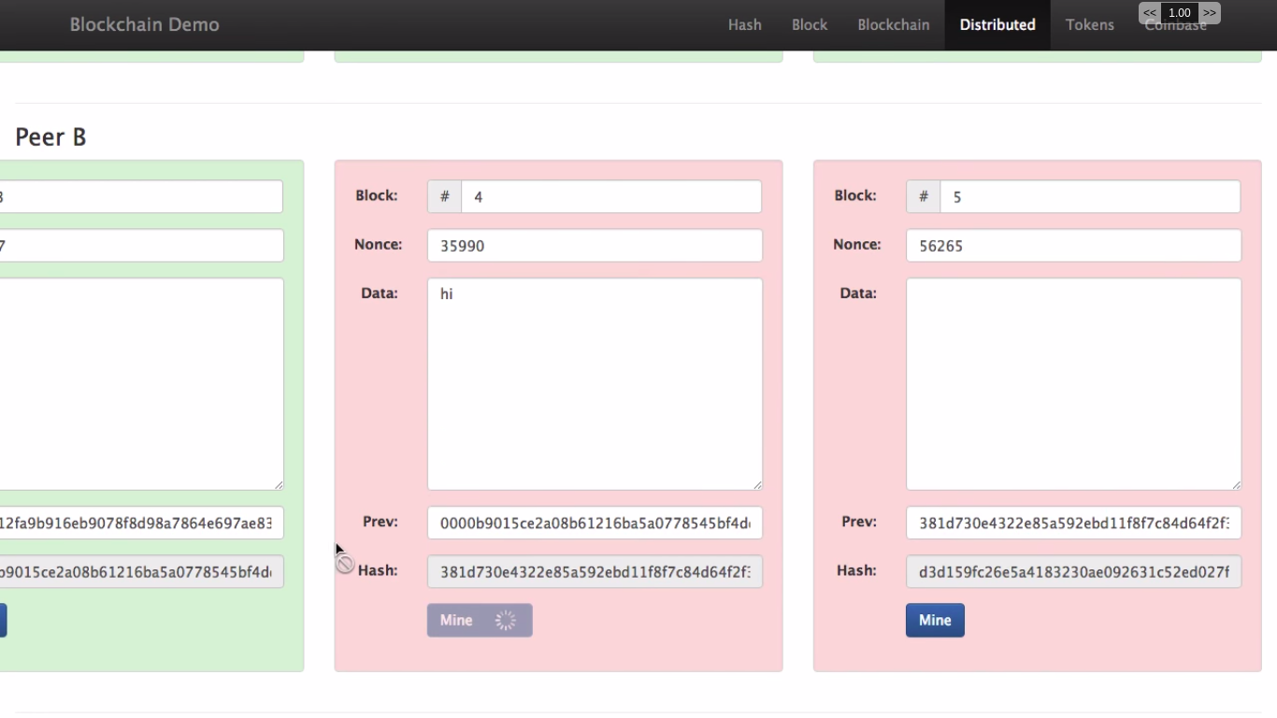
Notes:
20-Apr-18
9
9

Slide 10
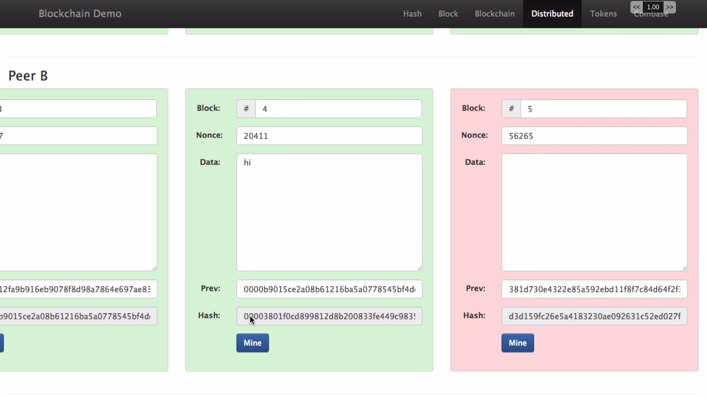
Notes:
20-Apr-18
10
10

Slide 11
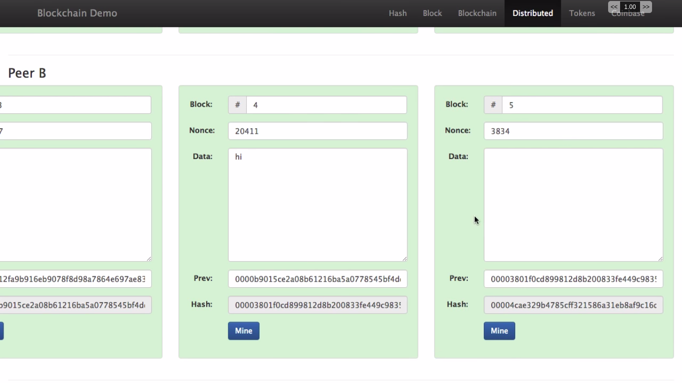
Notes:
20-Apr-18
11
11

Slide 12
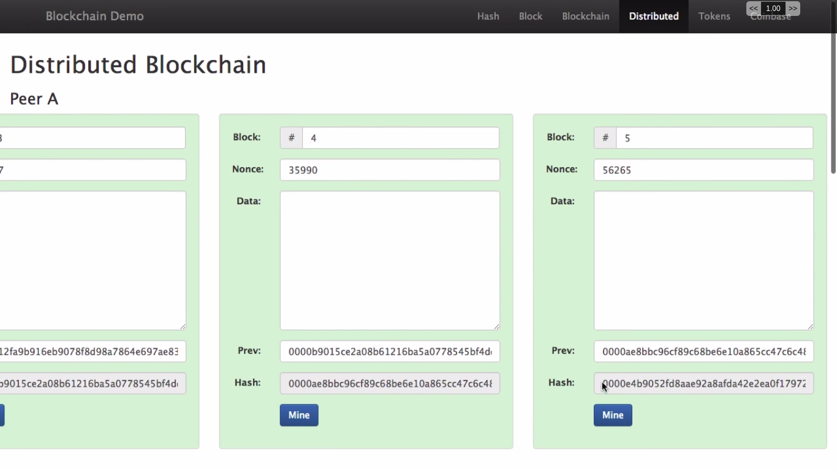
Notes:
20-Apr-18
12
12

Slide 13
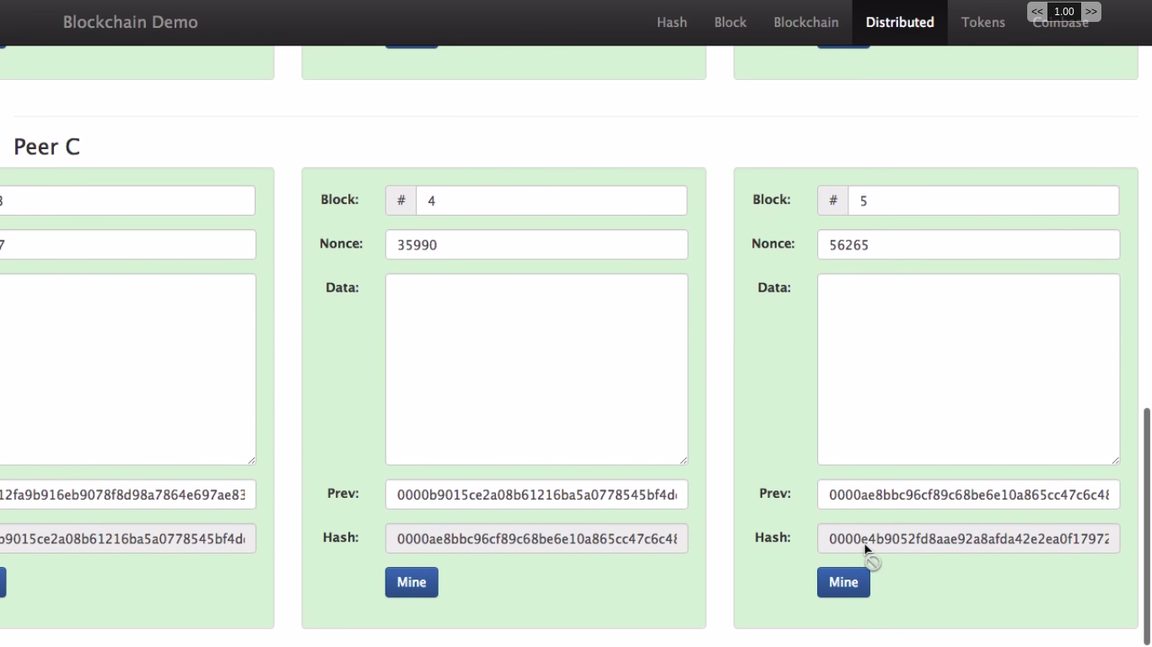
Notes:
20-Apr-18
13
13

Slide 14
Why Hyperledger Fabric?
Bitcoin uses “mining” as the way to update and extend the ledger.
Mining takes large amounts of computer power.
It also involves many mining teams over the Internet, each competing to be the one to add the next block to the ledger.
Blockchain for business and specifically for supply chain is not obliged to use mining.
There are other options for securely updating a business blockchain.

Slide 15
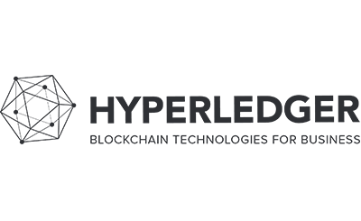
The Linux Foundation founded Hyperledger in 2015 to advance cross-industry blockchain technologies.
Hyperledger Fabric is one of the blockchain projects within Hyperledger. Like other blockchain technologies, it has a ledger, uses smart contracts, and is a system by which participants manage their transactions.

Slide 16
Where Hyperledger Fabric breaks from some other blockchain systems is that it is private and permissioned. Rather than an open permissionless system that allows unknown identities to participate in the network, the members of a Hyperledger Fabric network enroll through a trusted Membership Service Provider (MSP).

Slide 17
Components of Hyperledger
Chaincode - handles business logic agreed to by members of the network
Certification Authority - Validating a transaction request and certifying it for further processing
Endorsing peer - Simulation, Endorsement response, Cryptographic signing

Slide 18
Ordering Services - Evaluating the invocation request with respect to verification policies
Membership Service Provider - The Membership Service Provider (MSP) refers to an abstract component of the system that provides credentials to clients, and peers for them to participate in a Hyperledger Fabric network.
Channel - A channel is a private blockchain overlay which allows for data isolation and confidentiality.

Slide 19
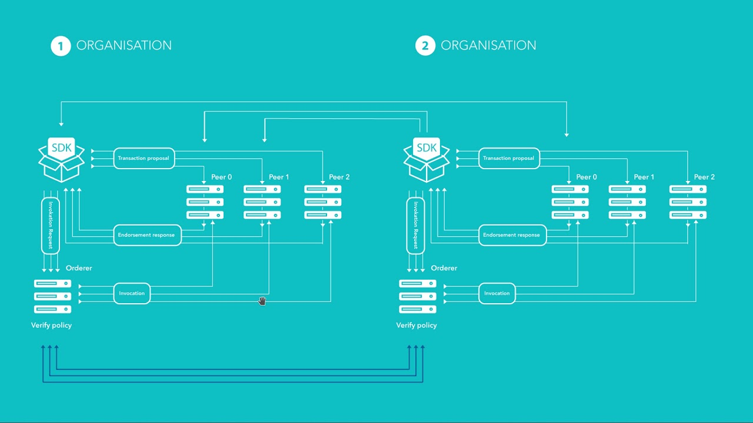
Transaction Flow

Slide 20
HyperLedger Composer
Hyperledger composer is an extensive, open development toolset and framework that runs on top of Hyperledger Fabric .
The primary goal is to enable easy and rapid development of blockchain application .
easier = faster = cheaper = popular with customer

Slide 21
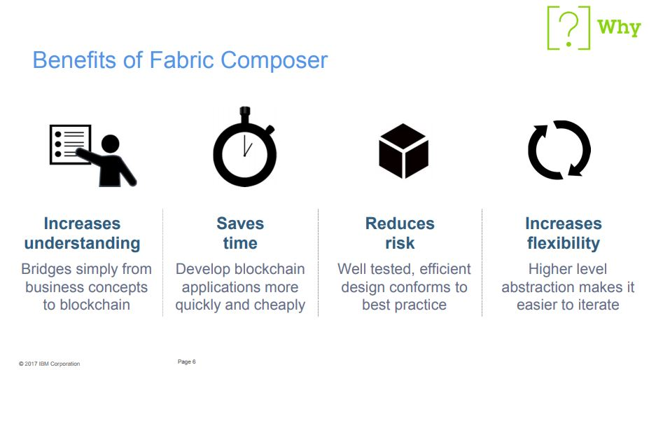

Slide 22
Key Components
Business Network:
A business network is a group of entities who work together to accomplish certain goals.
There must be an agreement among the members of the network regarding:
The goods and services that are exchanged.
Business rules governing payment and penalties
Which members within the group are allowed to participate, and when.

Slide 23
For Example, a perishable goods supply chain network is a business network involving:
Perishable items such as bananas, pears, and coffee.
Business partners such as growers, shippers, and importers.
Shipments of perishable goods.
Agreements between business parties that stipulate conditions of the agreements.
Acknowledgement of receipt of goods and services.

Slide 24
Asset:
An asset is anything of value that can be exchanged between parties in a business agreement.
For example the perishable goods themselves.
Participants:
A participant is a member of a business network.
For example the growers, shippers and importers.

Slide 25
Transactions
An Operation that potentially affects the state of the blockchain ledger is a transaction.
Examples of transactions in the Perishable Goods network include:
An Importer receives a shipment of perishable goods.
An IoT GPS sensor records the shipping container's current location at a particular interval of time.

Slide 26
Access Control
In a business network, not every participant has access to everything.
For example, a grower does not have access to the contract between the shipper and the importer.
Access control is used to limit who has access to what (and under what conditions).

Slide 27
In Fabric Composer, a business network is defined as:
A model definition file
A set of JavaScript processors (in a Script file)
An Access Control file
Model Definition File
Model file is the place where all the entities of the business network are defined.
That is, it describes the assets, transactions and events that exists in the business network.
Each will be having the set of variables and it’s types.

Slide 28
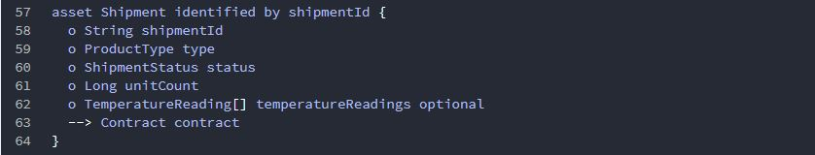

In the Perishable Goods network, a Shipment Asset is modeled
like this:
The Transaction Shipment Received is modeled this way:
A Participant Shipper is modeled in this way:

Slide 29
Script Files
This is the place where the transaction processor functions are defined.
It’s the business logic of the blockchain application where you’ll be defining what kind of operations can be done in the network.
That is, the business logic for each transaction is defined in the Script file.(Written in JavaScript)

Slide 30
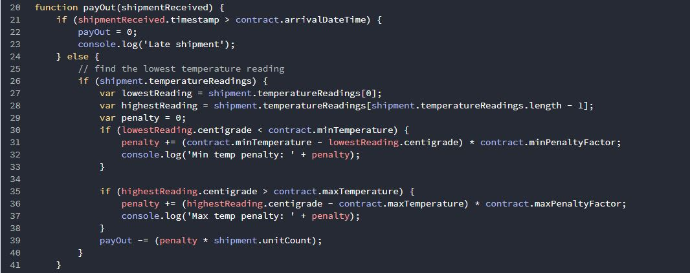
In the perishable goods networks, the Transaction processor function for Transaction shipmentReceived is as follows:

Slide 31
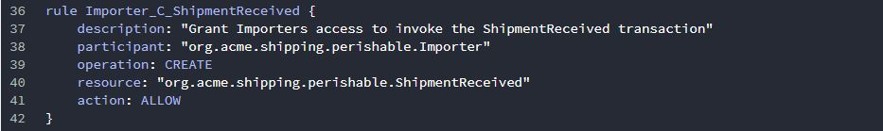
Access Control Files
In a business network, not every participant has access to everything.
These restrictions or role-based security is implemented through Access Control Files ie .acl files.

Slide 32
CONCLUSION
Thus we conclude to say that Hyperledger Fabric is a permissioned blockchain platform aimed at business use. It enforces a business process between parties that do not trust each other.
Implementation of the Supply Chain on the Blockchain eliminates discrepancies in the records and builds a system devoid of trust.

Slide 33
REFERENCES
[1] Iuon-Chang Lin and Tzu-Chun Liao, "A Survey of Blockchain Security Issues and Challenges," International Journal of Network Security, Vol.19, No.5, PP.653-659, Sept. 2017. (DOI: 10.6633/IJNS.201709.19(5).01)
[2] Linux Foundation, Hyperledger Architecture, Volume 1 Whitepaper. Retrieved from https://www.hyperledger.org/wp-content/uploads/2017/08/Hyperledger_Arch_WG_Paper_1_Consensus.pdf
[3] Satoshi Nakamoto, “metzdowd.com”, “Bitcoin: A Peer-to-Peer Electronic Cash System”.
[4] Sarah Underwood , “Blockchain Beyond Bitcoin”, DOI:10.1145/2994581 Nov, 2016
Marko Vukolic . "Rethinking Permissioned Blockchains". IBM Research - Zurich. DOI:10.1145/3055518.3055526

